Slide 1
1. Visits

Slide 2
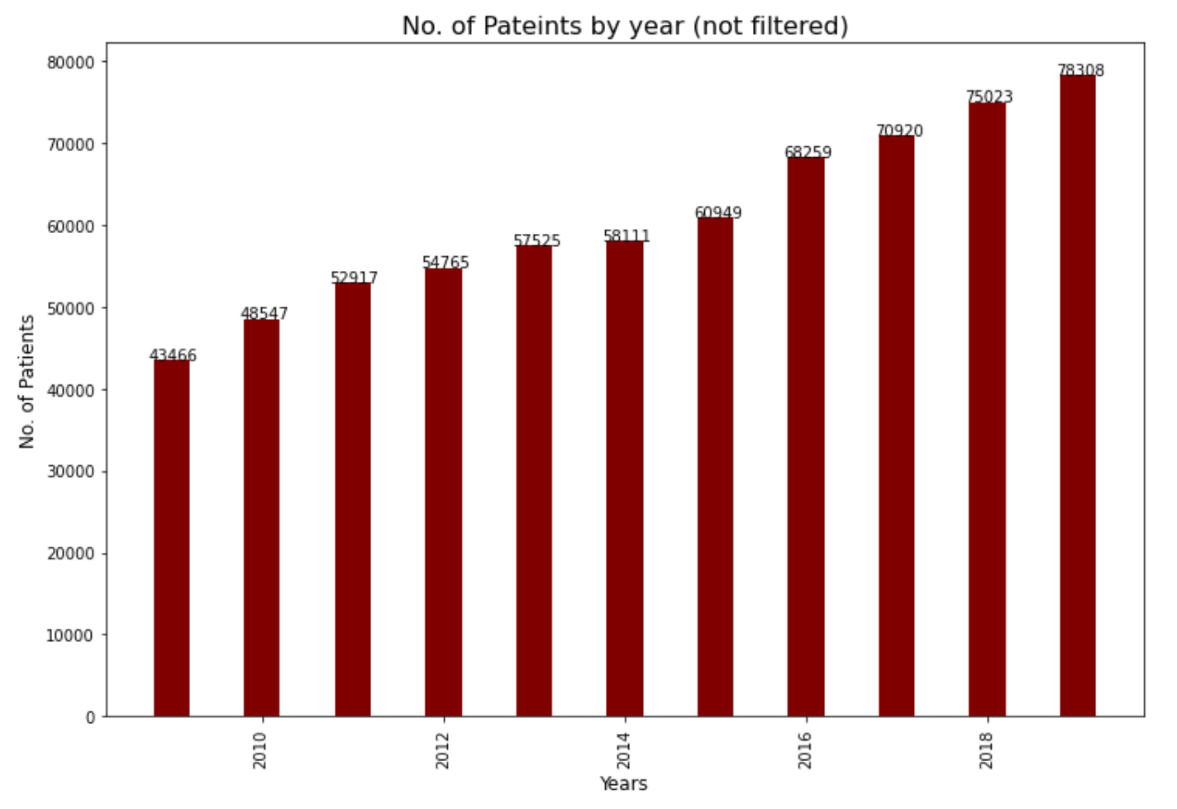
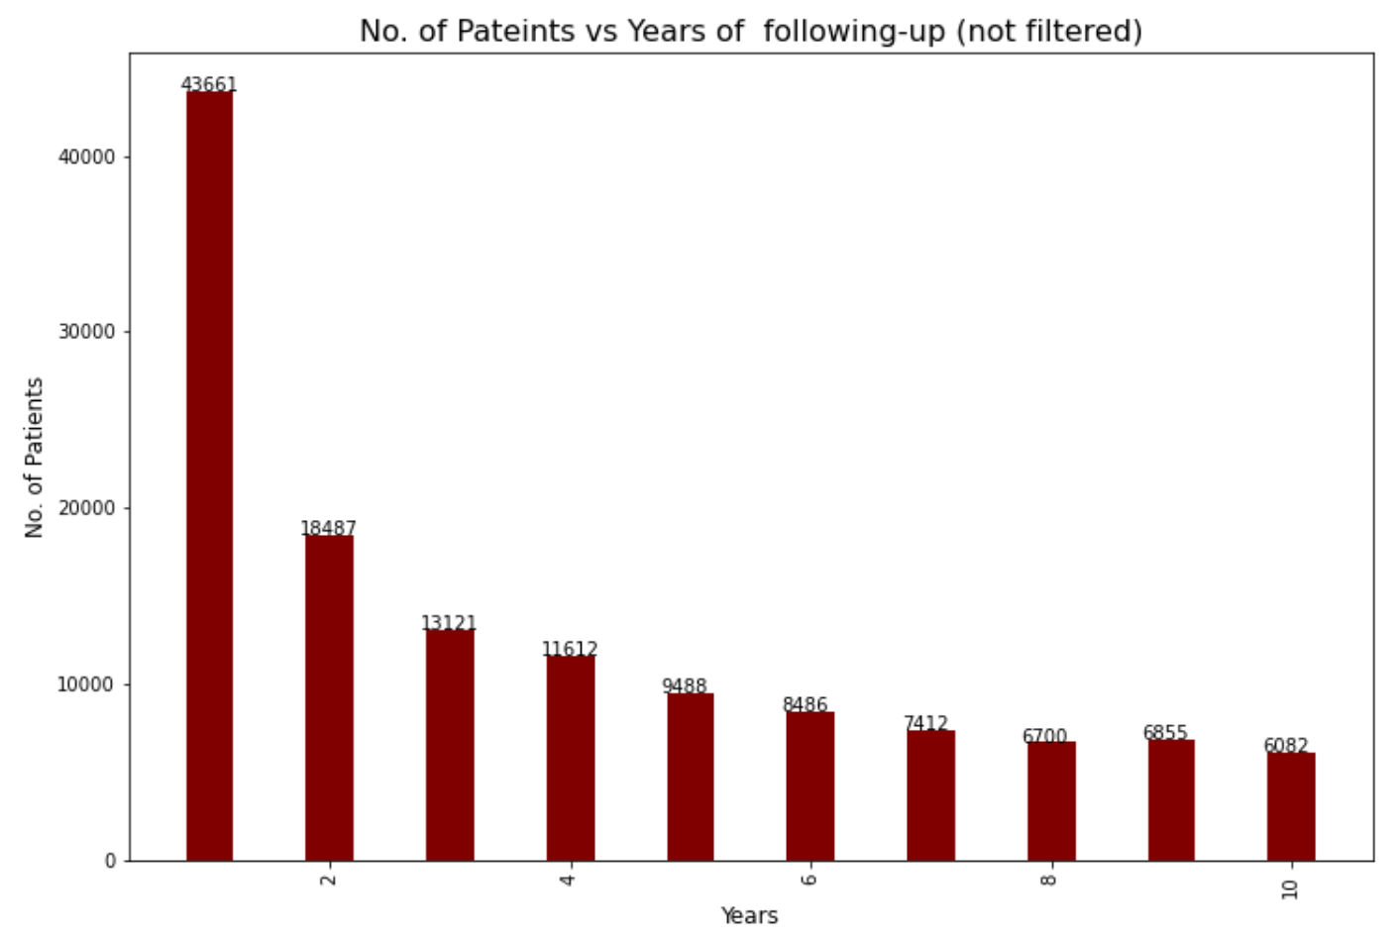
Visits(1/3) - All Combined files
147944 in total

Slide 3
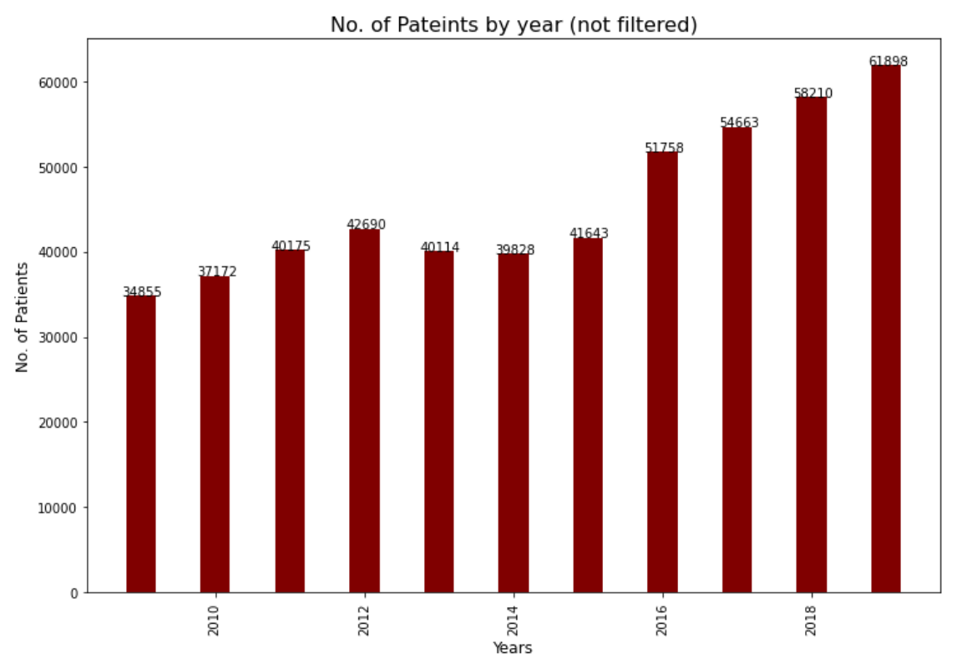
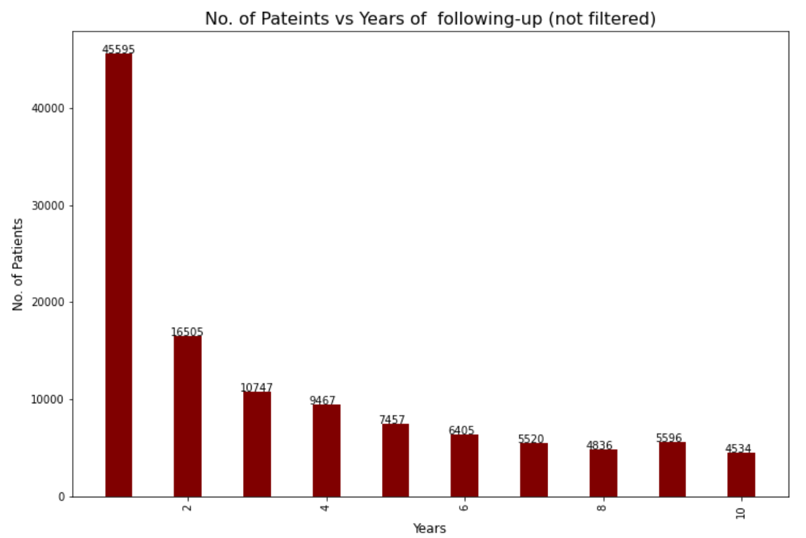
Visits(2/3) - Use drug excels only
126257 in total

Slide 4
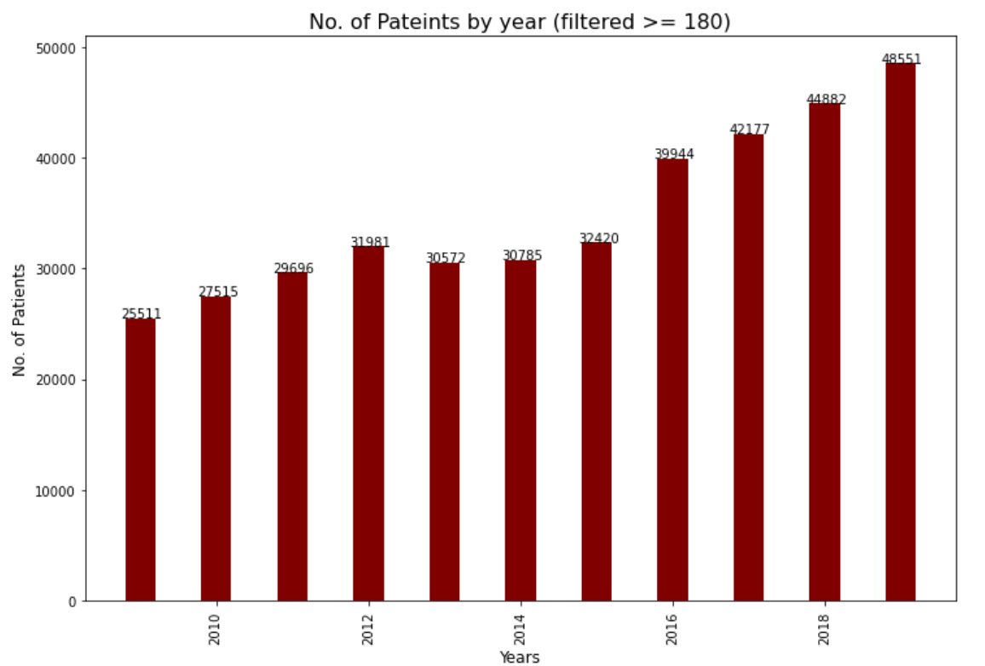
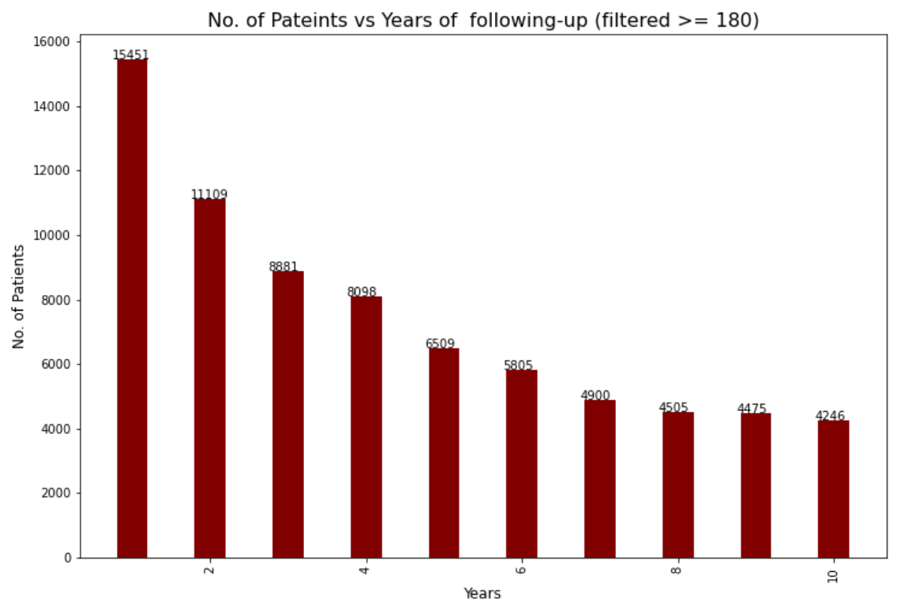
Visits(2/3) - Use drug excels only (>=180)
80059 in total

Slide 5
2. Summary of Drugs/Operations/Lasers

Slide 6
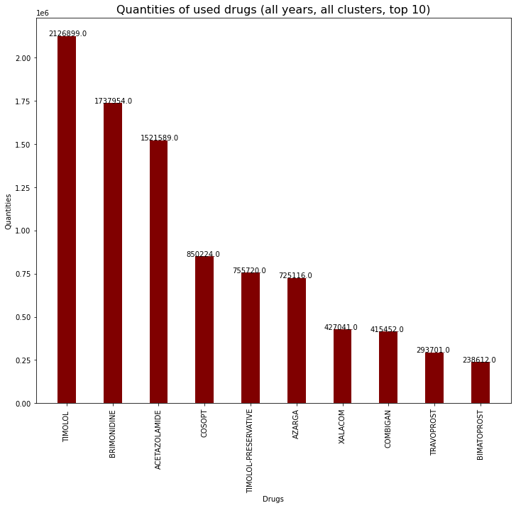
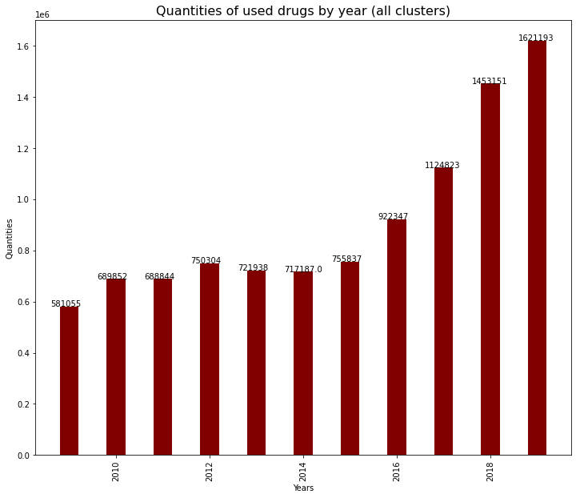
Drugs(23 types, patients >=180 only)

Slide 7
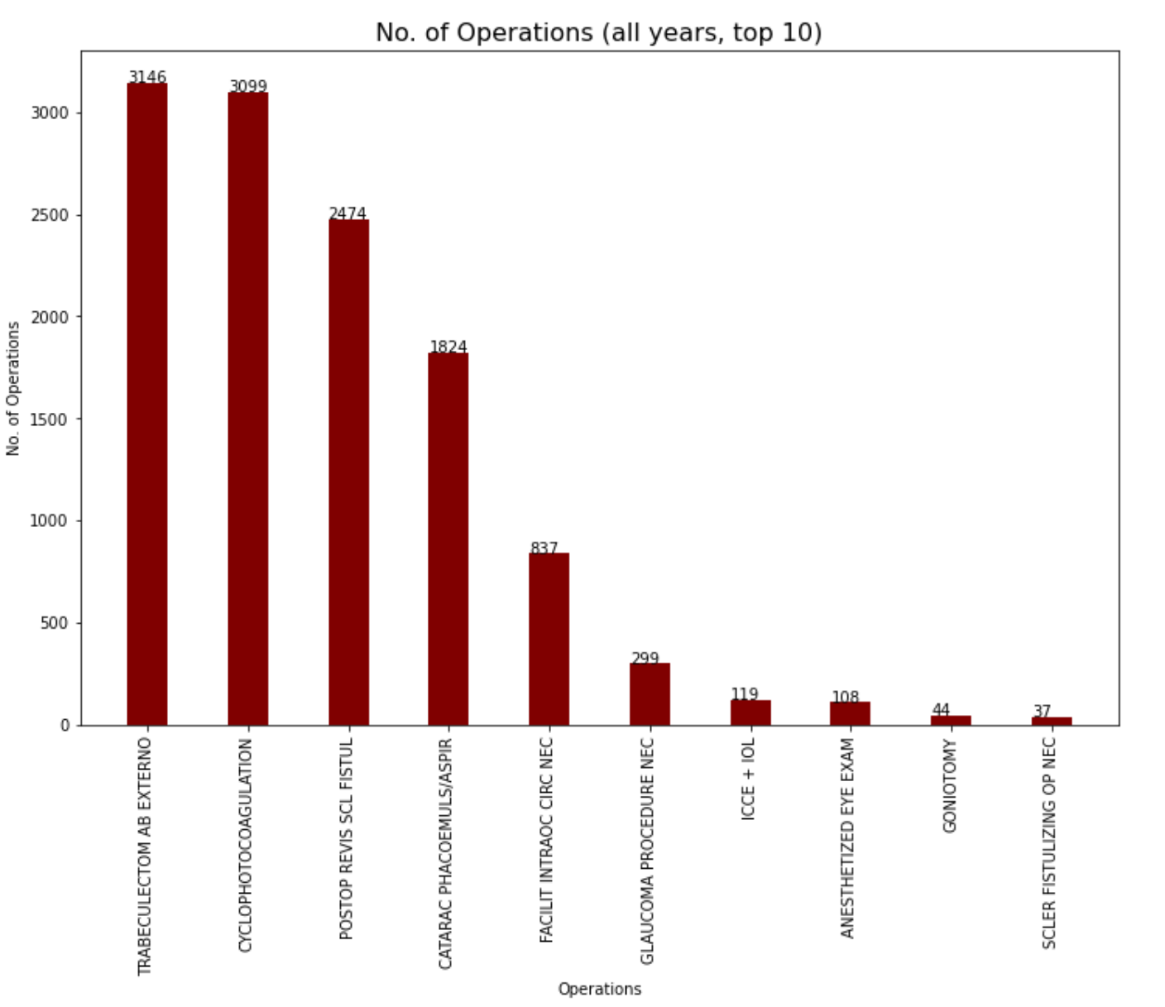
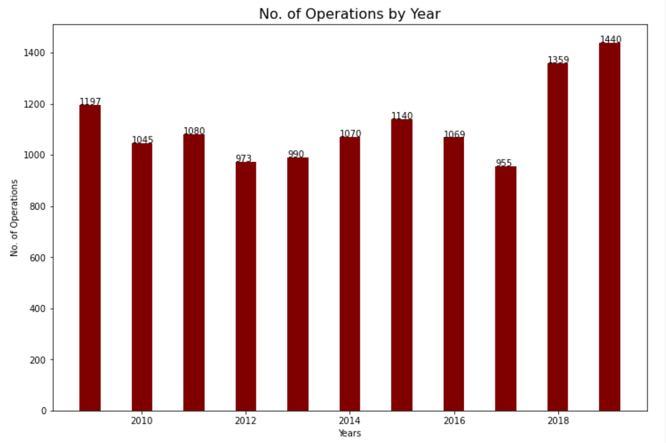
Operations(all 96 types)

Slide 8
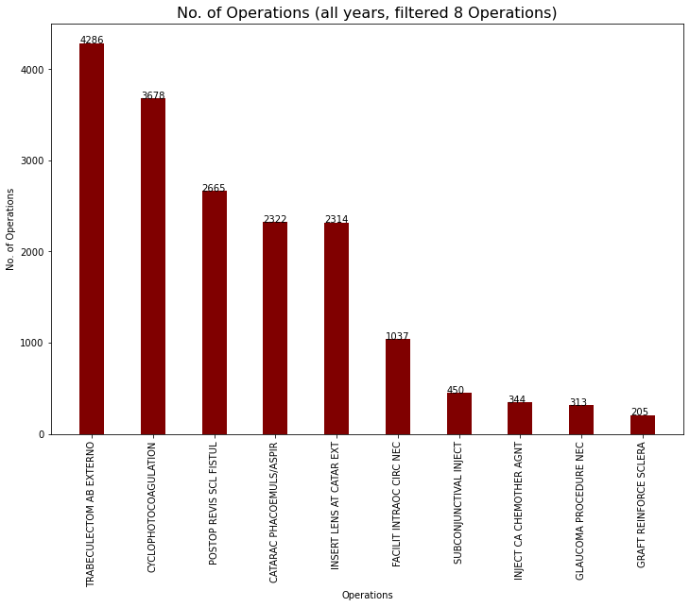
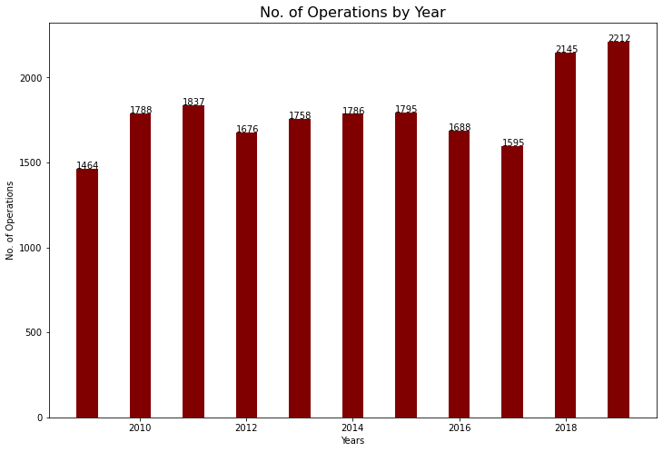
Filtered 8 operations

Slide 9
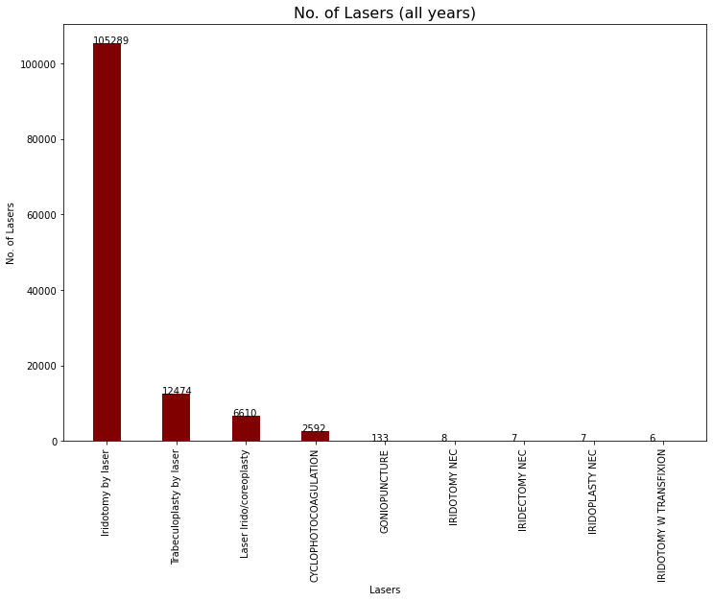
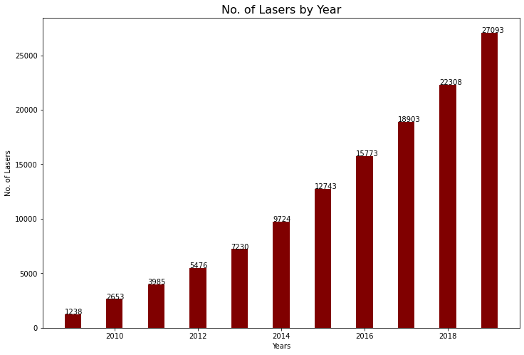
Laser (9 types)

Slide 10
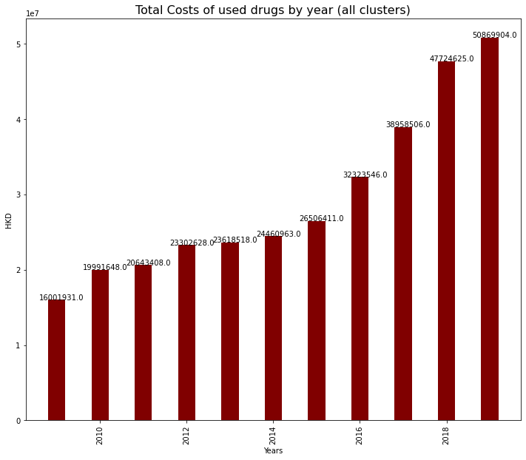
Total Costs(Drugs)(pateints >=180):

Slide 11
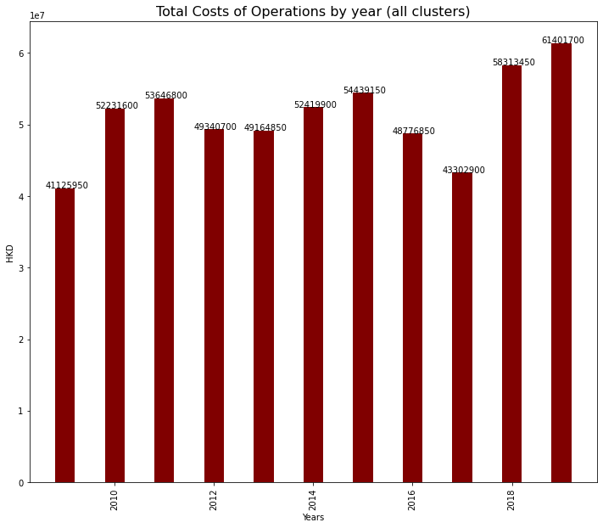
Total Costs(Operations):

Slide 12
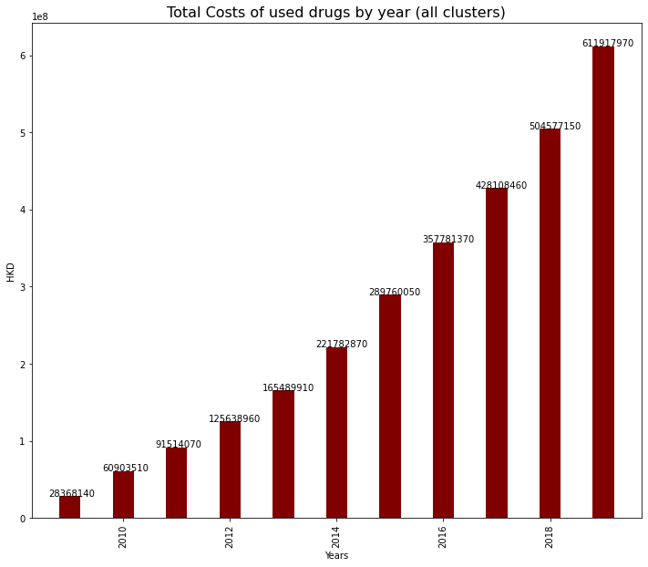
Total Costs(Lasers):

